Slide 1
Merton:
45度線
Leverage Value
TB
Equity
τCDT
α
BC
Debt
Debt
Asset Value
D+(1-τ)CDT

Slide 2
VL=D+E
Equity
Debt
Asset Value
D+(1-τ)CDT
D+(1-τ)CDT
1-α
1-α
Debt
Debt
D+(1-τ)CDT
D+(1-τ)CDT

Slide 3
VL=VA+TB-BC
45度線
45度線
TB
Asset Value
τCDT
D+(1-τ)CDT
α
α
BC
BC
Debt
Asset Value
D+(1-τ)CDT

Slide 4
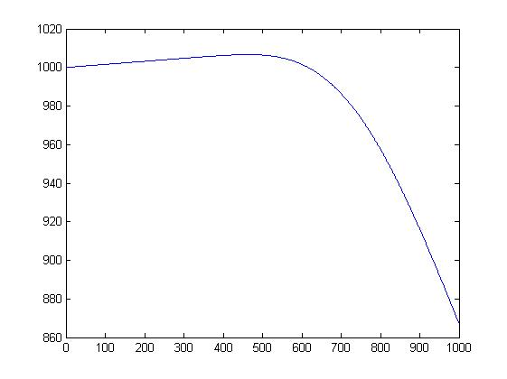
Initial asset value=1000, Coupon rate=0.05, Maturity=1, Tax rate=0.35, 破產成本比例=0.4, Risk free rate=0.1, Volatility=0.3, Debt=0~1000
The Optimal Debt=463,
Equity holder=567.5968, Debt holder=439.0555, VL=1006.6523

Slide 5
Merton(SE+RE):
45度線
TB
Equity
Leverage Value
RE
TB
mixEquity
τCDT
α
BC
SB
SB
Debt
Asset Value
D1+(1-τ)C1D1T
D1+D2+(1-τ)(C1D1+C2D2)T

Slide 6
VL=D+E, Equity部分
Equity
D1+D2+(1-τ)(C1D1+C2D2)T
45度線
mixEquity
D1+(1-τ)C1D1T
mixEquity
D1+(1-τ)C1D1T
D1+D2+(1-τ)(C1D1+C2D2)T

Slide 7
VL=D+E, Debt部分
RE
SB
Asset Value
Asset Value
D1+D2+(1-τ)(C1D1+C2D2)T
D1+(1-τ)C1D1T
1-α
1-α
SB
SB
D1+(1-τ)C1D1T
D1+(1-τ)C1D1T

Slide 8
Equity:
+
乘上比例
Equity
mixEquity
D1+D2+(1-τ)(C1D1+C2D2)T
D1+(1-τ)C1D1T
RE:
+
乘上比例
RE
mixEquity
Asset Value
D1+(1-τ)C1D1T
D1+D2+(1-τ)(C1D1+C2D2)T
+
SB:
1-α
SB
SB
Asset Value
D1+(1-τ)C1D1T
D1+(1-τ)C1D1T

Slide 9
VL=VA+TB-BC
45度線
45度線
45度線
TB1
TB2
Asset Value
Τ(C1D1+C2D2)T
τC1D1T
D1+(1-τ)C1D1T
D1+D2+(1-τ)(C1D1+C2D2)T
α
α
BC
BC
Debt
Asset Value
D+(1-τ)CDT

Slide 10
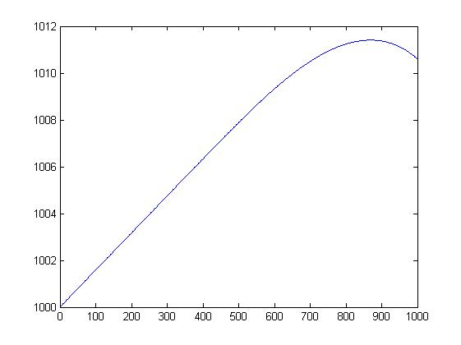
Initial asset value=1000, SB Coupon rate=0.05, RE Coupon rate=0.05, Maturity=1, Tax rate=0.35,破產成本比例=0.4, Risk free rate=0.1, Volatility=0.3, Number of initial Stock=100, Conversion Price=10, SB/D=0.5, Debt=0~1000
The Optimal Debt=869,
Equity holder=282.8188, SB holder=412.4029, RE holder=316.1875, VL=1011.4092

